Slide 1
Advanced Leopard Seal Recognition System (ALSRS)
Bryce Robinson, Carson Buntin, Carsyn Smeda, Nathan Hontz, Juncheng Li, Ryan Huntington
Seal Team 6
Notes:
Carsyn

Slide 2

Happywhale
Website dedicated to marine wildlife conservation and education
Photographers can upload pictures of marine wildlife
Experts with Happywhale can identify individuals and track them
Currently machine learning algorithms to identify whales based on images of their tail
Notes:
Carsyn

Slide 3
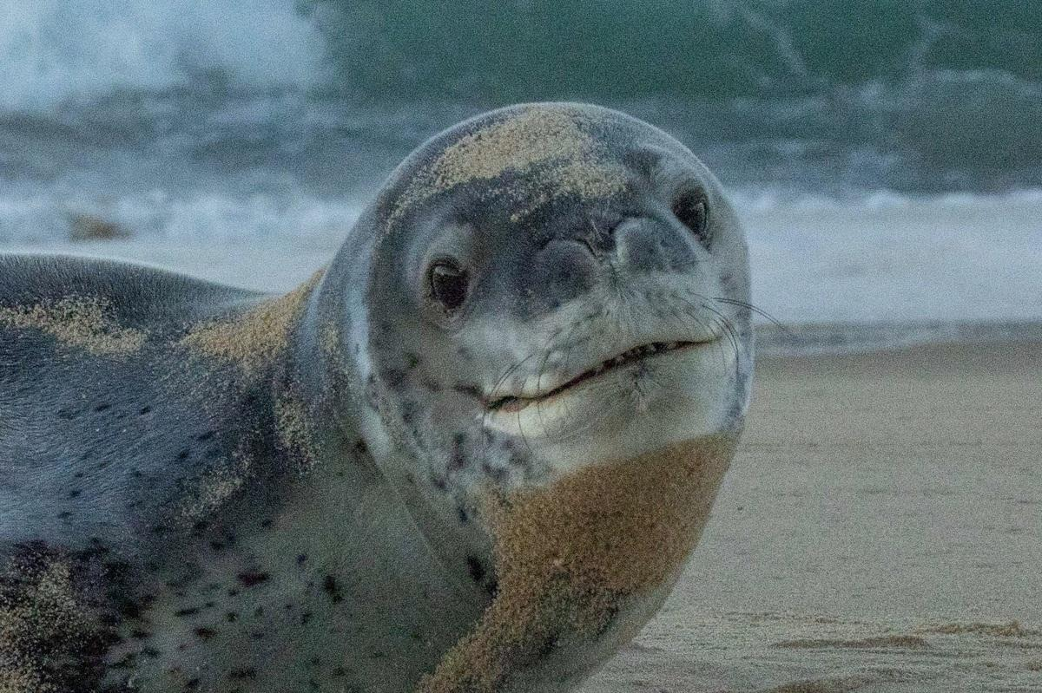
Project Overview
Current lack of effective tools to detect and identify individual leopard seals
Develop API for Happywhale.com capable of receiving leopard seal photographs and returning the identity of any recognized seals
Utilization of two machine learning models for detection and identification of leopard seals
Notes:
Carson

Slide 4

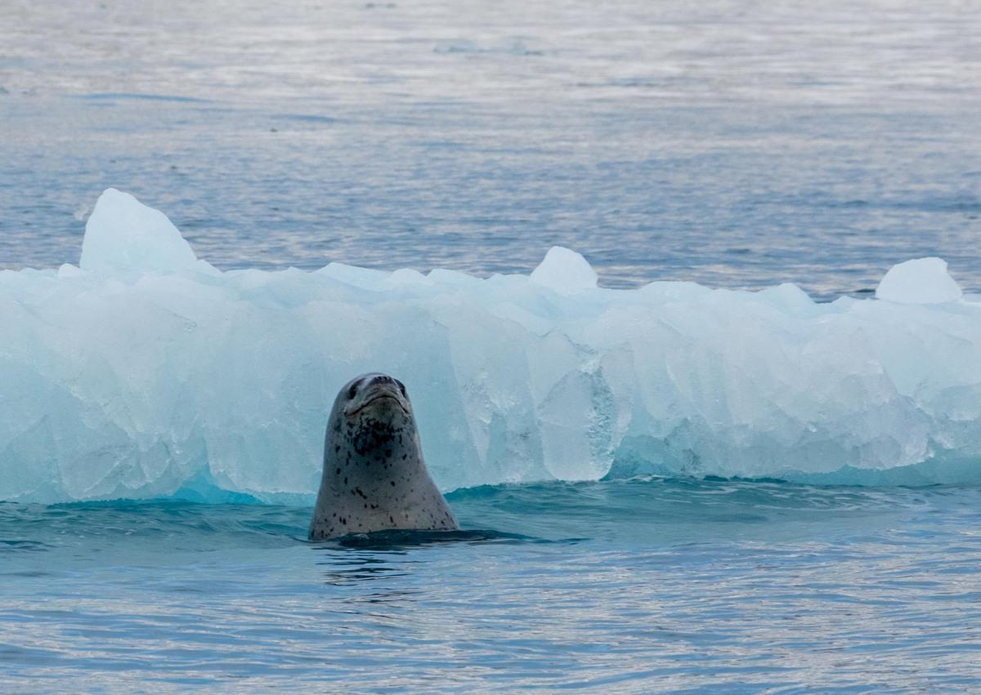
Overview of pipeline
API
Detection Model
Identification Model
Ellie 98%
Notes:
Carson

Slide 5
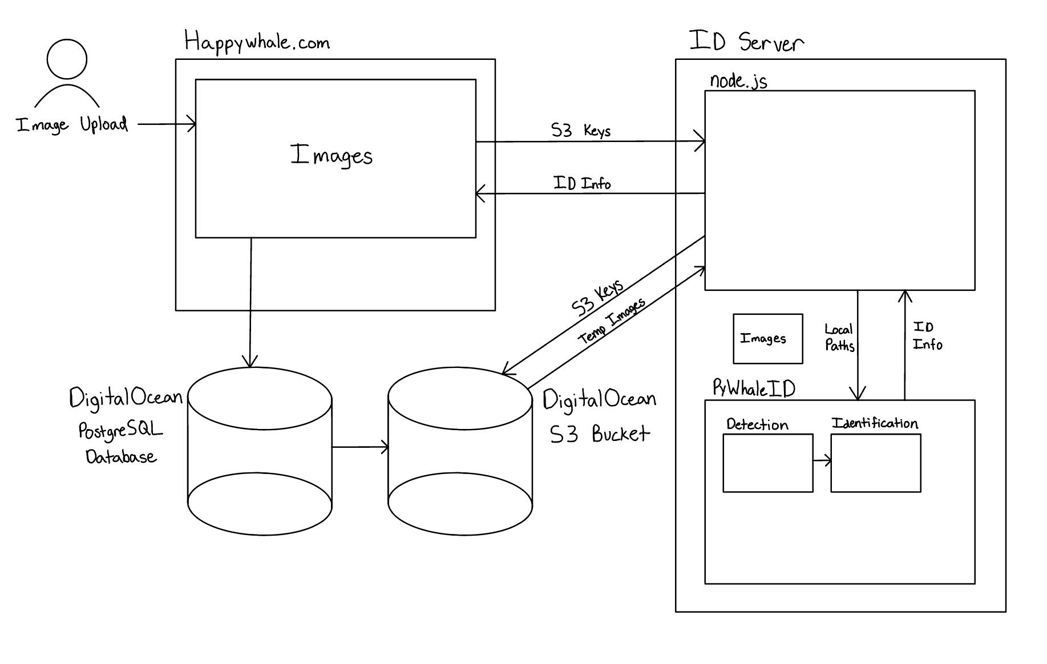
Happywhale System Architecture
Notes:
Bryce

Slide 6
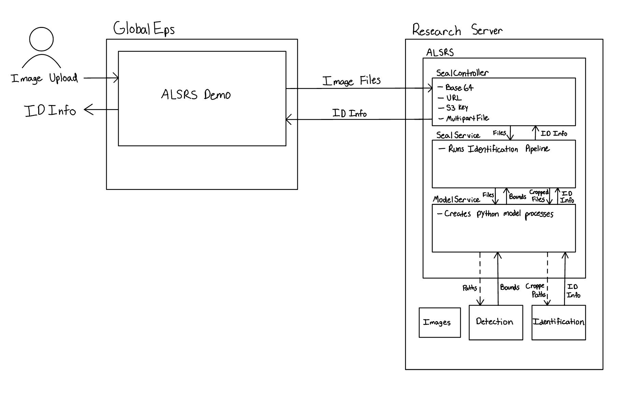
Demo System Architecture
Notes:
Bryce

Slide 7



API Design
The API is capable of handling three unique formats of seal images:
Base64: Images encoded in Base64
URL: Images retrieved from an image’s URL
S3: Images retrieved from an S3 bucket using its S3 key
Users can choose what model to use for seal detection
Notes:
Carson

Slide 8
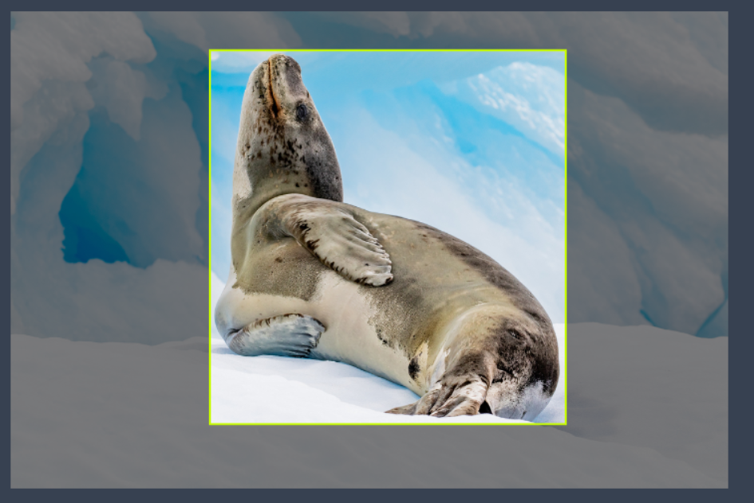
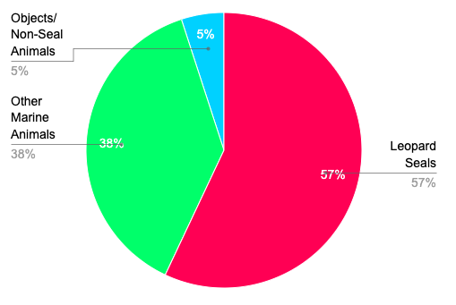
Dataset Compilation
Detection Dataset
Images from Happywhale
Leopard seals
Other seal species
Sea lions
Non-seal images from COCO dataset
Scenery
Objects
Non-seal animals
Total number of images: 1000 originally, 2400 with augmentation
Identification Dataset
Identified leopard seals from Happywhale
968 images
53 identities
Dataset split per identity
70% Train
20% Valid
10% Test
Notes:
Nathan

Slide 9
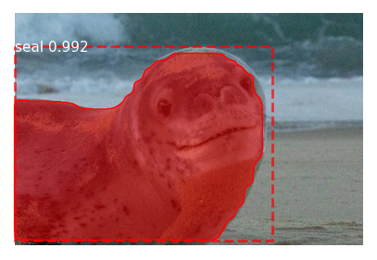
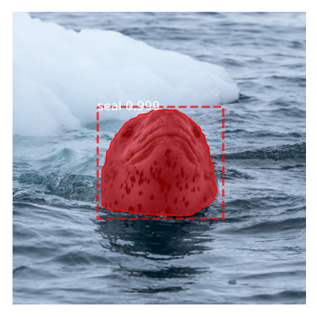
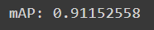
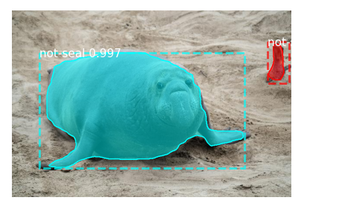
Detection Model: Mask R-CNN
Extension to Faster R-CNN that predicts segmentation masks as well as bounding boxes
Can predict leopard seals vs non-leopard seals with high accuracy
mAP score of 0.91 for final model
Notes:
Nathan

Slide 10
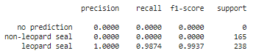
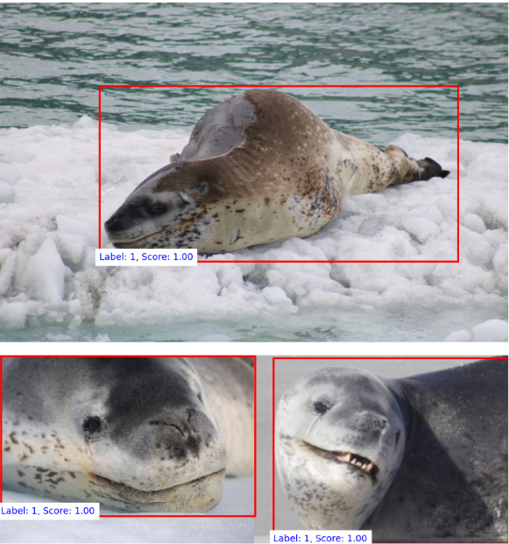
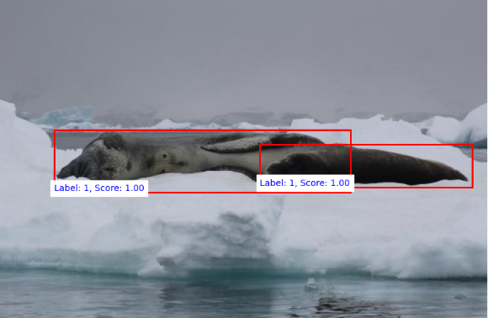
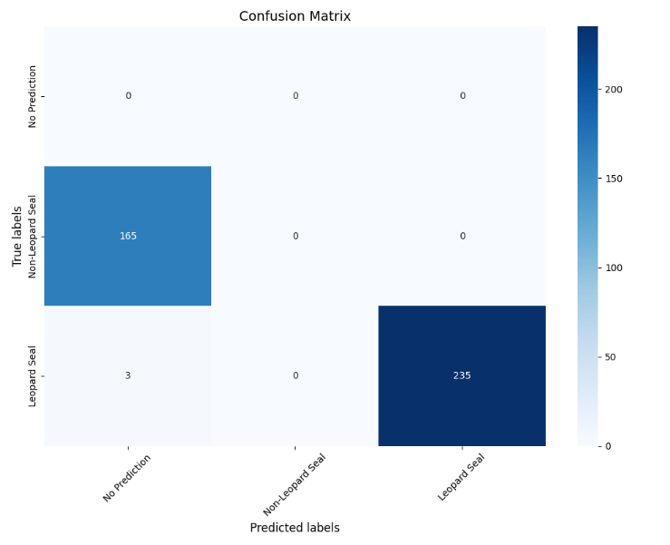
Detection Model: Faster R-CNN
Capabilities:
Detect multiple leopard seal in one image
Distinguish leopard seals from other species of seals
Draw precise bounding boxes
Notes:
Juncheng

Slide 11
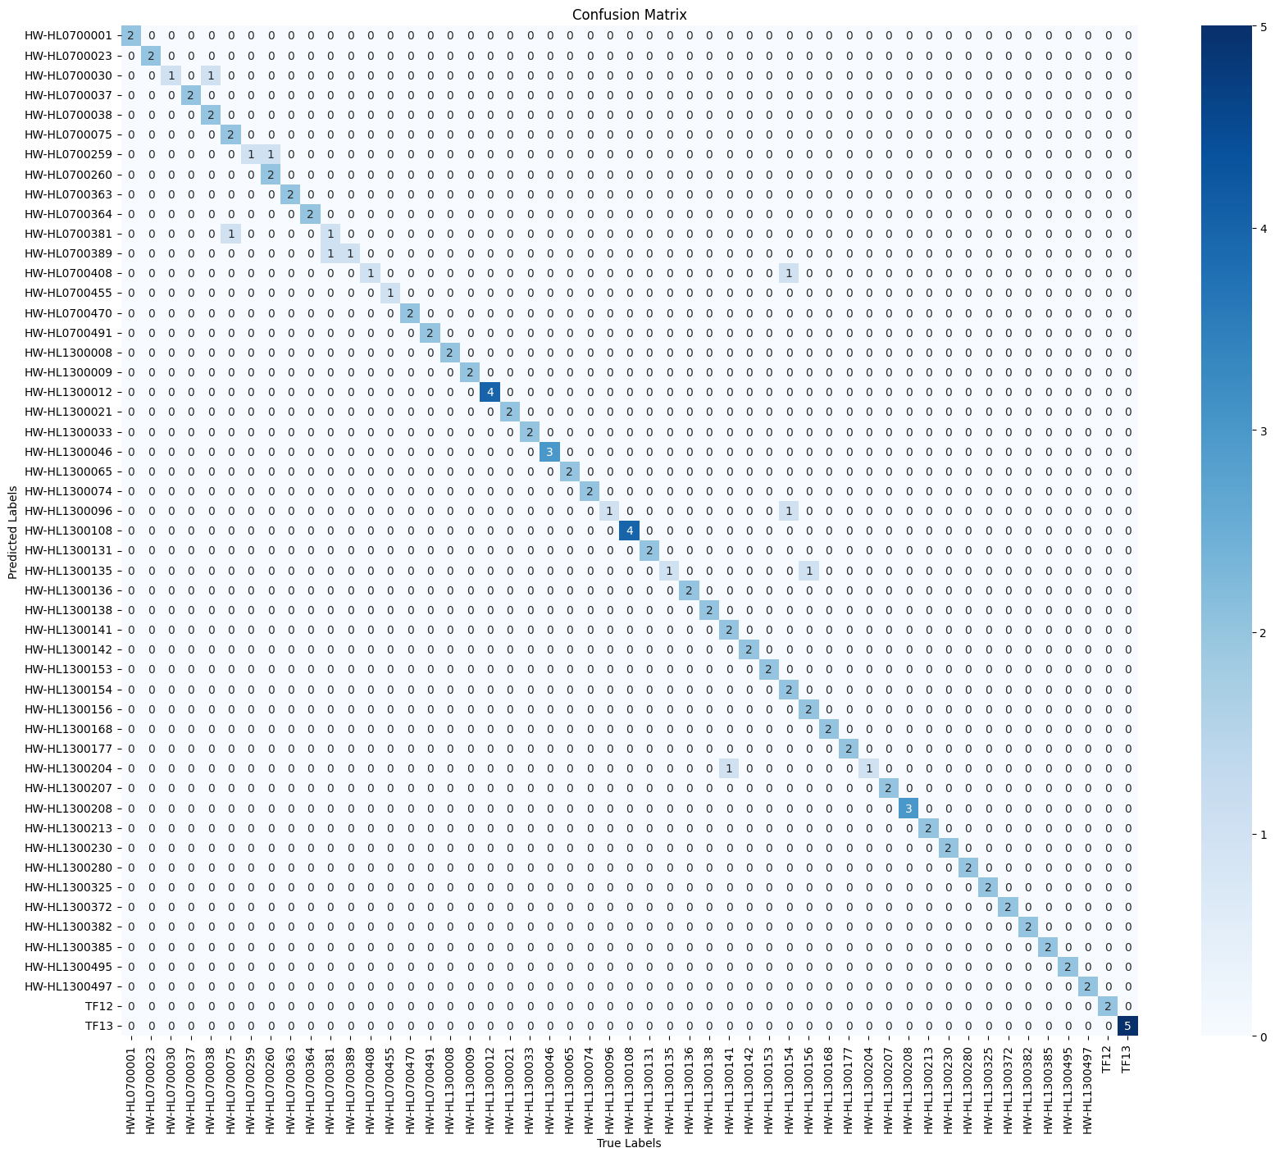
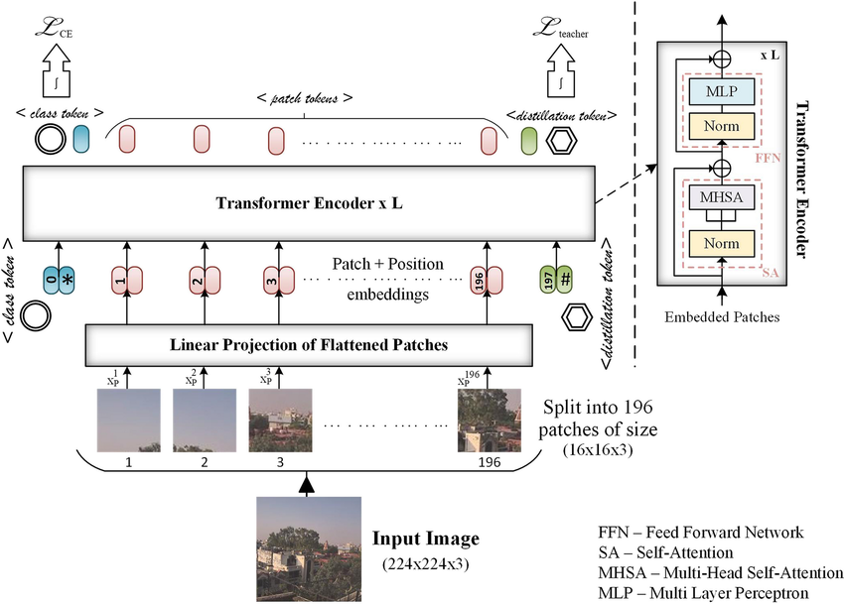
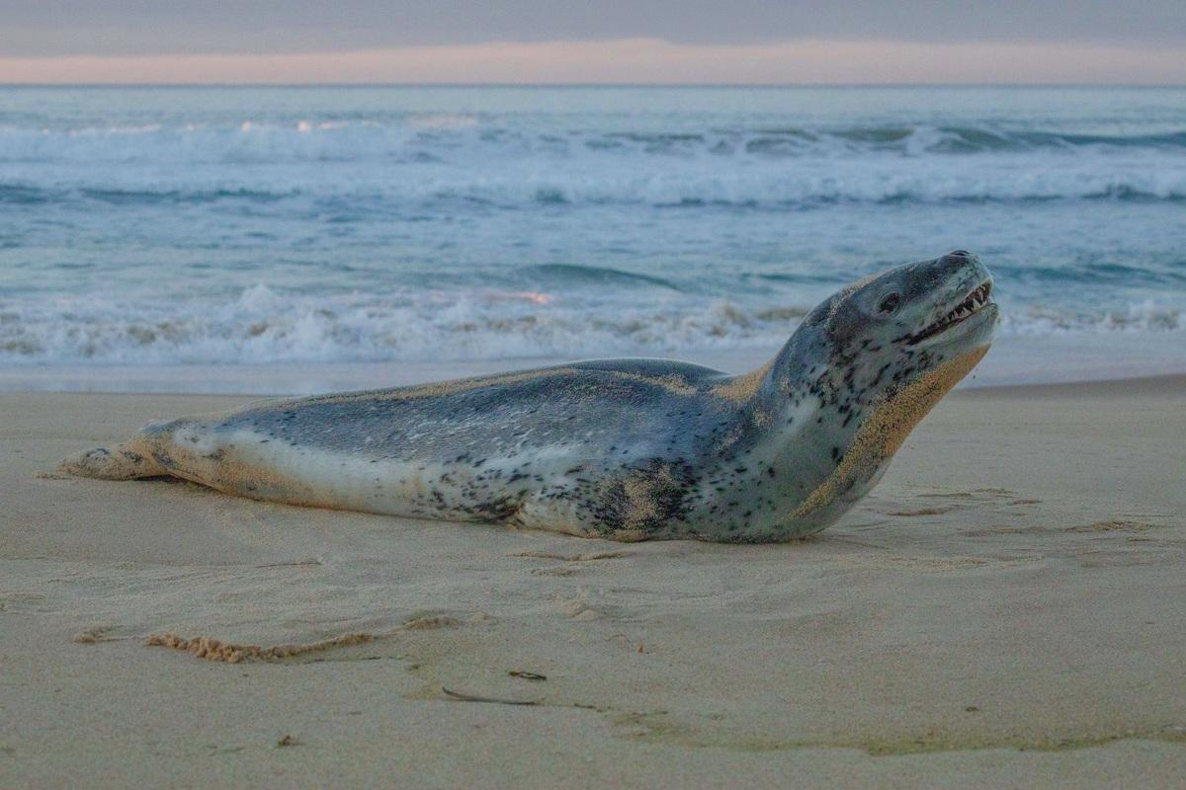
Identification Model
Competitor: ViT (Vision Transformer)
Our Choice: DeiT (Data-efficient image Transformer)
Notes:
Ryan

Slide 12
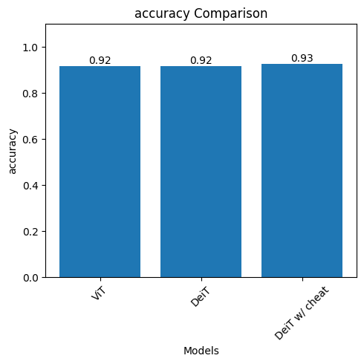
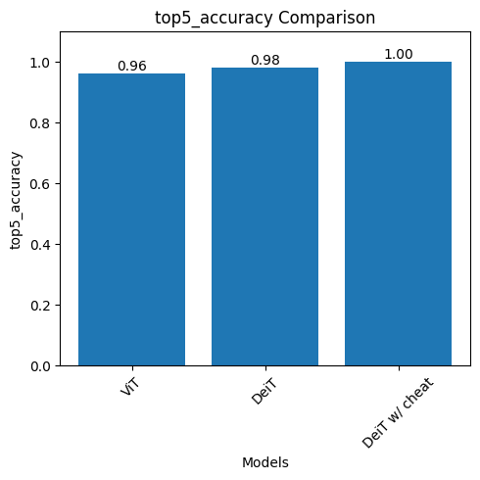
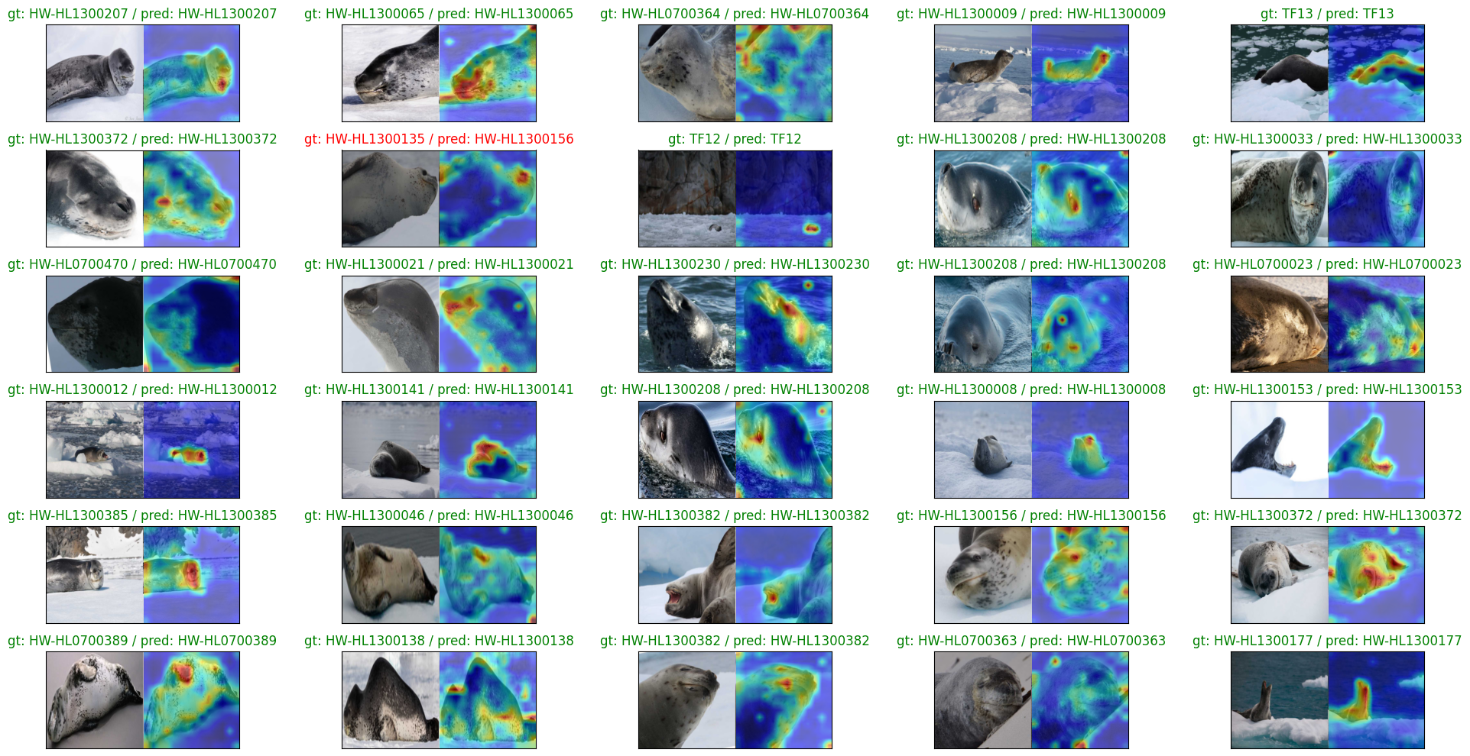
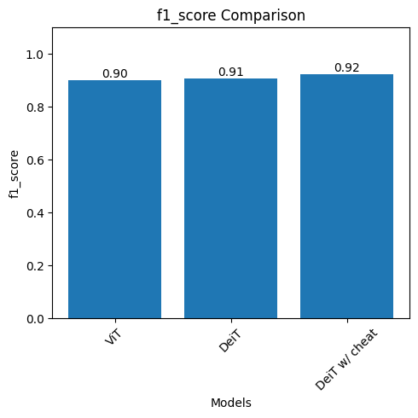
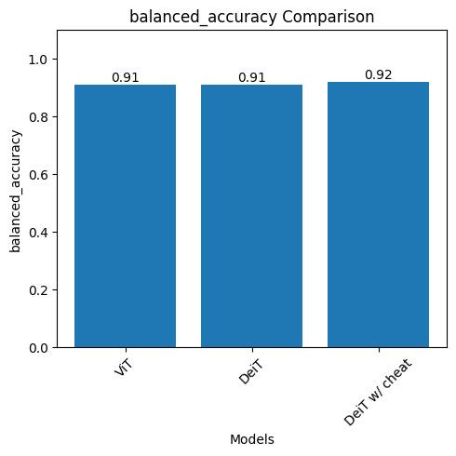
Identification Model Results
Notes:
Ryan

Slide 13
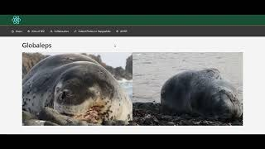
Frontend Demo
Notes:
Carsyn
What do the numbers from ID mean why are they not 0-1?
Thats just the score they get back from the model. Numbers range from -6 to 14 (so far) but idk, thats just how the model works. The higher the number, the more sure the model is

Slide 14
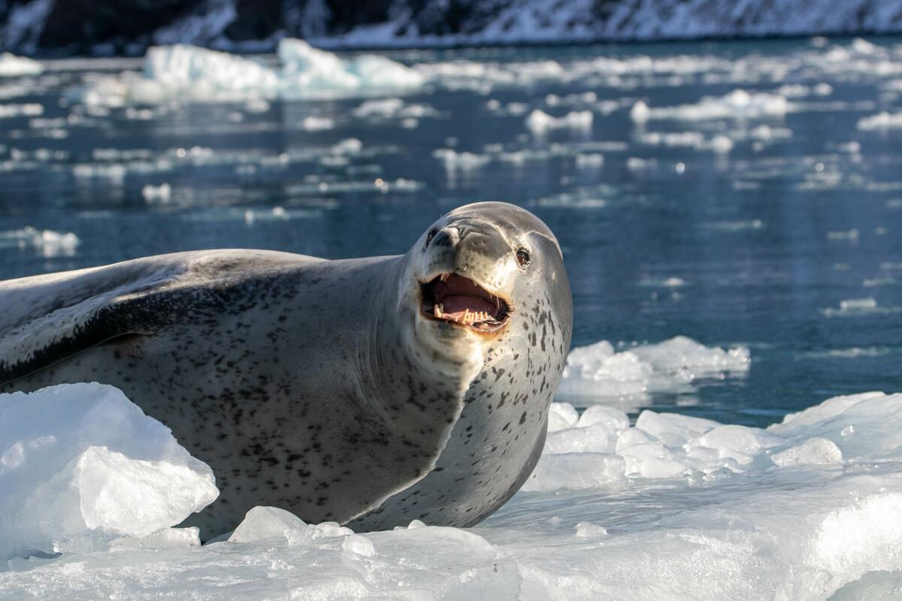
Potential Future Development
Conversion of Python model scripts to Python server for Happywhale integration (as with PyWhaleID)
Addition of methods for creation of new seal IDs when all possible IDs are below a threshold value
Addition of a feature extractor to improve identification model feature focus and accuracy
Notes:
Bryce

Slide 15
Thank You!

